Slide 1
Department of Environmental Quality
Interbasin Transfer Program Update
Water Allocation Committee March 9, 2016

Slide 2
Proposed Project Description
Primary Applicant: | Union County
Source Basin: | Yadkin
Receiving Basin: | Rocky
Grandfathered Allowance: | N/A
Total Requested IBT (2050 Demands): | 23 MGD (avg day/max mth)
New Certificate, following G.S. 143-215.22L(c-n)
Department of Environmental Quality

Slide 3
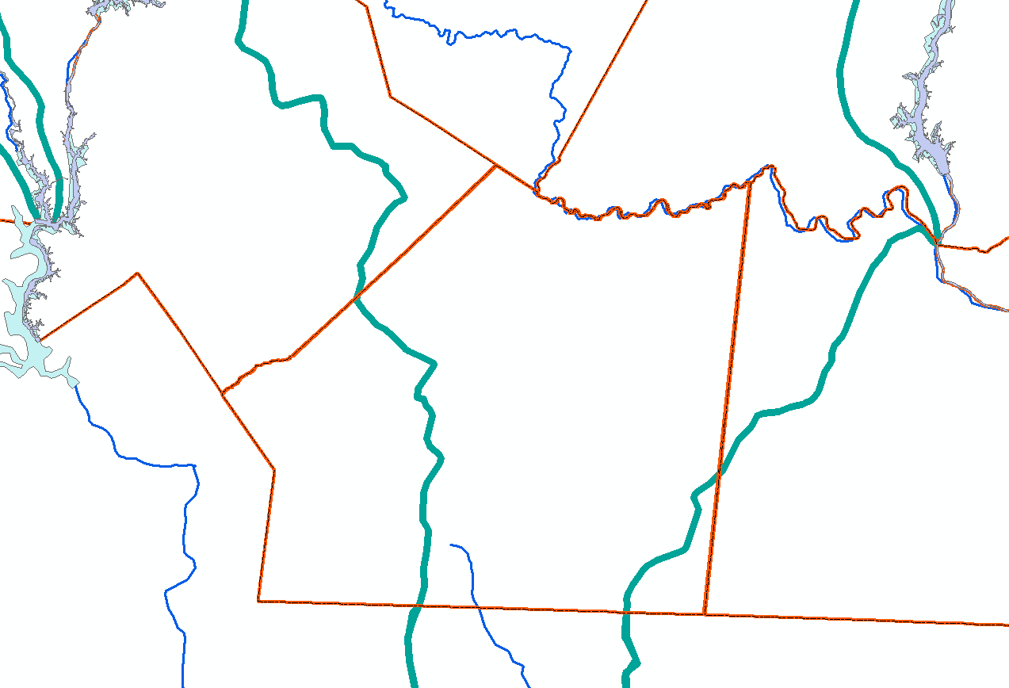
Lake Tillery
Cabarrus
Stanly
Norwood
Catawba River Basin
Mecklenburg
Proposed 23.0 mgd IBT: Yadkin to Rocky
Union
Monroe
Yadkin River Basin
Rocky River Basin
South Carolina
Existing 5.0 mgd Grandfathered IBT: Catawba to Rocky
Anson

Slide 4
IBT Process § 143-215.22L
✓ I. Applicant submits Notice of Intent to file a petition.
30 days notice of public meetings
3+ Public meetings
✓ II. Applicant submits draft environmental document (EIS or EA)
30 days notice of public hearing
Public hearing
Comments accepted for 30 days after hearing
Written response to comments prepared
Adequacy of environmental document determined (DEQ issues ROD)
Settlement discussions, if requested
➔ III. Applicant submits petition to EMC
EMC issues Draft Determination within 90 days of receiving petition and adequacy of doc determined
Public notice of draft determination and 30-day notice of hearings
2+ public hearings held within 60 days of issuing draft determination
Written response to comments prepared
Comments accepted for 30 days after last hearing
EMC issues final determination

Slide 5
Current and Upcoming Actions
Final EIS completed State Clearinghouse review February 11th
One comment submitted
DOA determined no further environmental review action needed
Record of Decision (ROD) prepared by DEQ
Draft petition submitted by applicant February 23rd
At the May WAC/EMC meetings: seek Draft Determination on petition for IBT certificate and assignment of hearing officer

Slide 6
Contact Information
Kim Nimmer
NCDEQ - Division of Water Resources
kim.nimmer@ncdenr.gov
919-707-9019
Department of Environmental Quality

